Slide 1

CS 561: Artificial Intelligence
Instructors: Profs. Laurent Itti (itti@usc.edu), Wei-Min Shen (shen@isi.edu),
Sheila Tejada (stejada@usc.edu) & Ning Wang (nwang@ict.usc.edu)
TAs:
Lectures: M-W 17:00 – 18:20, – or – Tues. 18:40 – 21:20, SGM-123
Office hours: Mon 13:00 – 14:00, HNB-SGM-123 07A (Prof. Itti)
Discussion: Profs. Shen, Tejada & Wang
This class will use courses.uscden.net (Desire2Learn, D2L)
- Up to date information
- Lecture notes
- Homeworks posting and submission information
- Grades
- Relevant dates, links, etc.
Textbook: [AIMA] Artificial Intelligence: A Modern Approach, by Russell & Norvig. (3rd ed)
Optional (ALFE): Autonomous Learning from the Environment by Shen
Chi-An Chen - chianc@usc.edu (50%)
Thomas Collins - collinst@usc.edu (50%)
Daniel Link - dlink@usc.edu (25%)
Qian Wang - wang215@usc.edu (50%)
Wuxuan Jiang - wuxuanji@usc.edu (50%)
Kan Qi - kqi@usc.edu (50%)
Bo Wang - wang736@usc.edu (50%)
Ali Kazemian - akazemia@usc.edu (50%)
John Tran - jtran@isi.edu

Slide 2
CS 561: Artificial Intelligence
Course overview: foundations of symbolic intelligent systems. Agents, search, problem solving, logic, representation, reasoning, symbolic programming, and robotics.
Prerequisites: CS 455x, i.e., programming principles, discrete mathematics for computing, software design and software engineering concepts. Good knowledge of C++ and STL, or Java, or Python needed for programming assignments.
Grading: 20% for midterm-1 +
20% for midterm-2 +
30% for final +
30% for 3 mandatory homeworks/assignments

Slide 3
CS 561: Artificial Intelligence
Grading:
Grading is absolute and according to the following scale:
>= 90 A+ (honorary – shows as A on transcript)
>= 80 A
>= 75 A-
>= 70 B+
>= 60 B
>= 55 B-
>= 50 C+
>= 40 C
>= 35 C-
< 35 F

Slide 4
Practical issues
Class mailing list: will be setup on the D2L system
Homeworks: See class web page on D2L. Homeworks are programming assignments.
Aug 28 – HW1 out Topic: search
Sep 20 – HW1 due
Sep 25 – HW2 out Topic: game playing or constraint satisfaction
Oct 16 – HW2 due
Oct 18 – HW3 out Topic: logic reasoning and inference or neural networks
Nov 20 – HW3 due
Late homeworks: you lose 20% of the homework’s grade per 24-hour period that you are late. Beware, the penalty grows very fast: grade = points * (1 – n * 0.2) where n is the number of days late (n=0 if submitted on time, n=1 if submitted between 1 second and 24h late, etc).
Homework grading: your hws will be graded by an A.I. agent (given to you in advance for testing) through the online system at vocareum.com.
Grade review / adjustment: Requests will be considered up to 2 weeks after the grade is released. After that, it will be too late and requests for grading review will be denied.
Exams:
Monday, September 25, 8:00pm – 9:50pm – midterm 1 (room TBA)
Monday, October 30, 8:00pm – 9:50pm – midterm 2 (room TBA)
Friday, December 8, 8:00am – 10:00am – final (room TBA)

Slide 5
More on homeworks and grading
In each homework you will implement some algorithms from scratch.
But our goal is to focus on A.I. algorithms, not on low-level programming. Hence I recommend C++/STL so that you can use the STL containers (queue, map, etc) instead of pointers and memory management. But the language you use is up to you.
Code editing, compiling, testing: we will use www.vocareum.com which will be linked to desire2learn (this is in progress at this time).
Vocareum supports several languages, the choice of which you use is up to you: C, C++, C++11, Java, Python, etc.
Your program should take no command-line arguments. It should read a text file called “input.txt” that contains a problem definition. It should write a file “output.txt” with your solution. For each homework, format for files input.txt and output.txt will be specified and examples will be given to you.
The grading will, 50 times:
Create an input.txt file
Run your code
Compare output.txt created by your program with the correct one.
If your outputs for all 50 test cases are correct, you get 100 points.
If one or more test case fails, you get 50 – N points where N is the number of failed test cases.

Slide 6
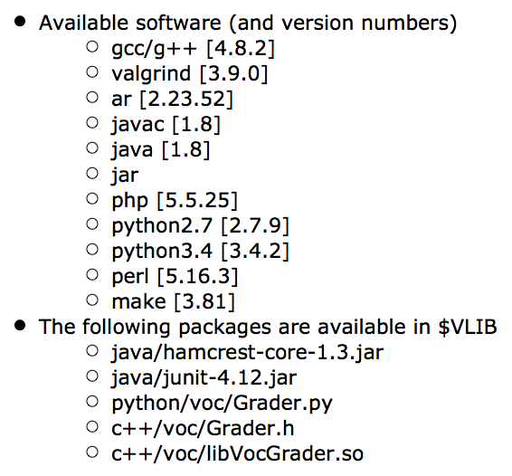
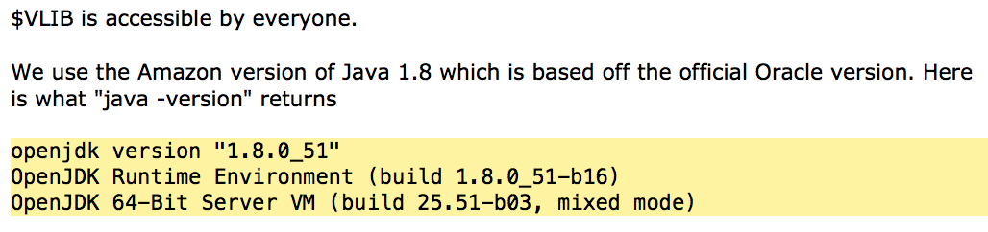
Vocareum.com
Note: this was as of September
2016. Updated compilers may be
available by the time HW1 is
released.

Slide 7
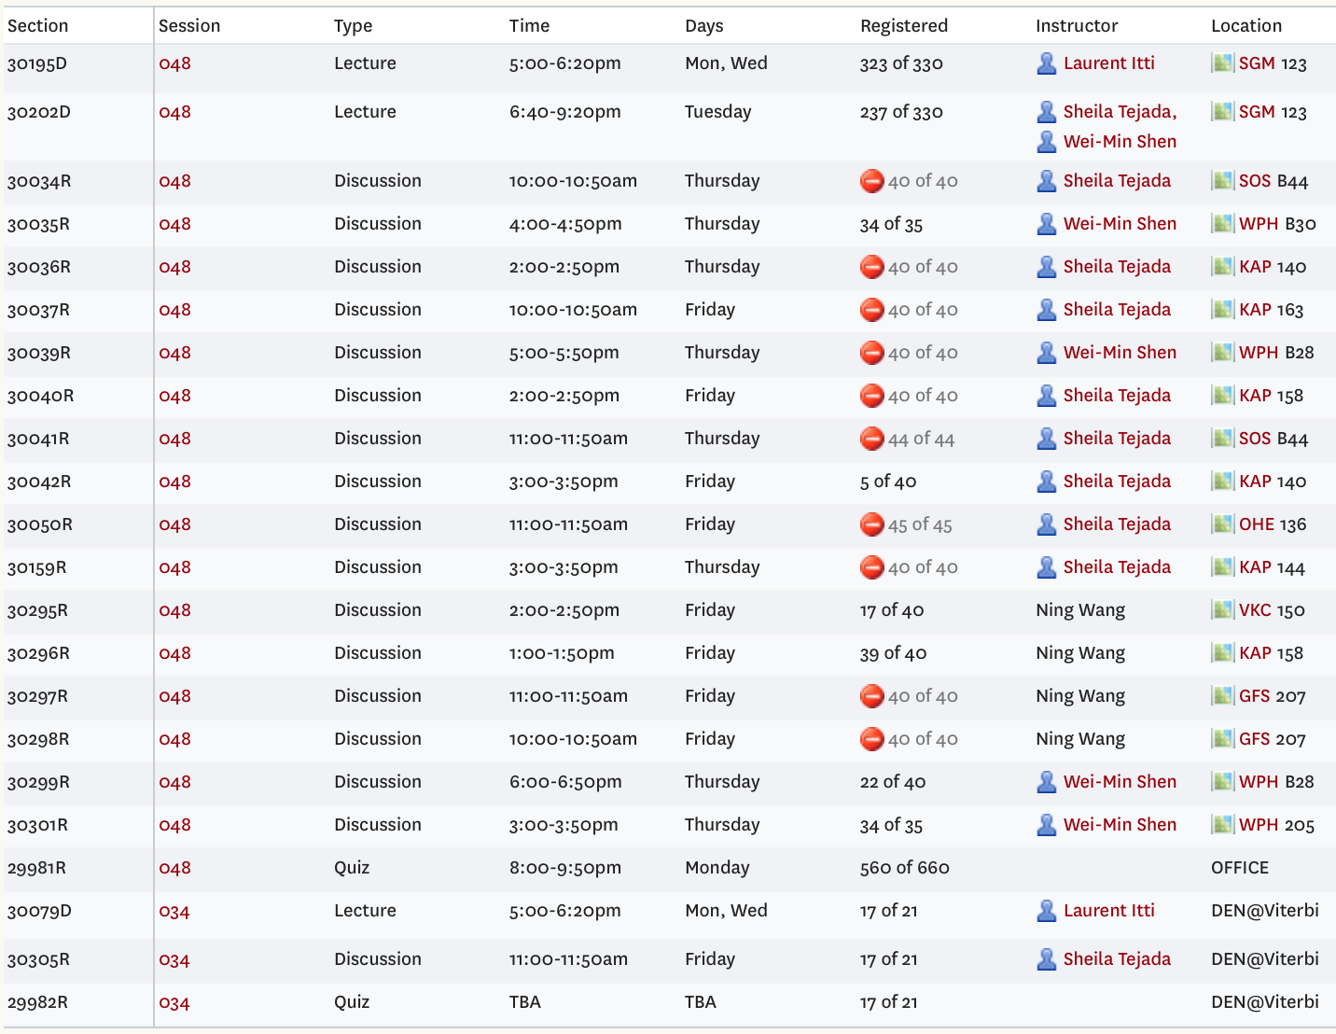
Discussion sections
You must register for one
lecture section (either M-W or
Tues).
You must register for one
discussion section.
You must also register for
the Quiz section on Mondays.
There will not be a quiz every
week. This slot is reserved
so we can have the entire
Class (M-W section + Tues
section) take the exam at the
same time. It will be used only
for the two midterm exams.
Discussion sections will
Provide more details, discussion and examples on complex topics
Run algorithms on more complex examples than during lectures
Relate lecture concepts to latest research topics
Showcase cool demos of recent A.I. achievements

Slide 8
Academic Integrity
Familiarize yourself with the USC Academic Integrity guidelines.
Violations of the Student Conduct Code will be filed with the Office of Student Judicial Affairs, and appropriate sanctions will be given.
Homework assignments are to be solved individually.
You are welcome to discuss class material in review groups, but do not discuss how to solve the homeworks.
Exams are closed-book with no questions allowed.
Please read and understand:
http://policy.usc.edu/student/scampus/
https://sjacs.usc.edu/students/

Slide 9
Academic Integrity
All students are responsible for reading and following the Student Conduct Code. Note that the USC Student Conduct Code prohibits plagiarism.
Some examples of what is not allowed by the conduct code: copying all or part of someone else's work (by hand or by looking at others' files, either secretly or if shown), and submitting it as your own; giving another student in the class a copy of your assignment solution; and consulting with another student during an exam. If you have questions about what is allowed, please discuss it with the instructor.
Students who violate university standards of academic integrity are subject to disciplinary sanctions, including failure in the course and suspension from the university. Since dishonesty in any form harms the individual, other students, and the university, policies on academic integrity will be strictly enforced. Violations of the Student Conduct Code will be filed with the Office of Student Judicial Affairs.

Slide 10
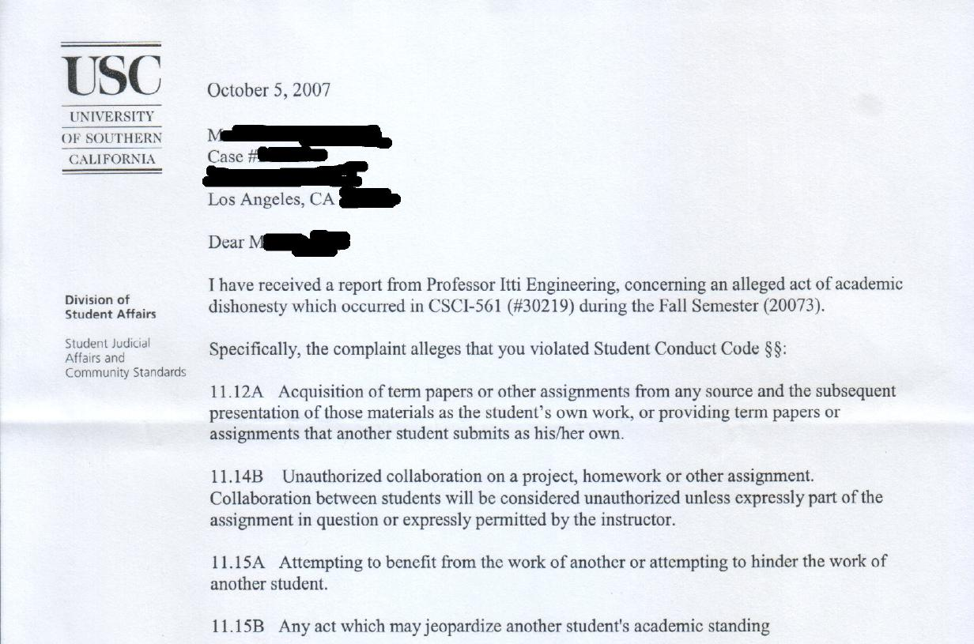

Slide 11
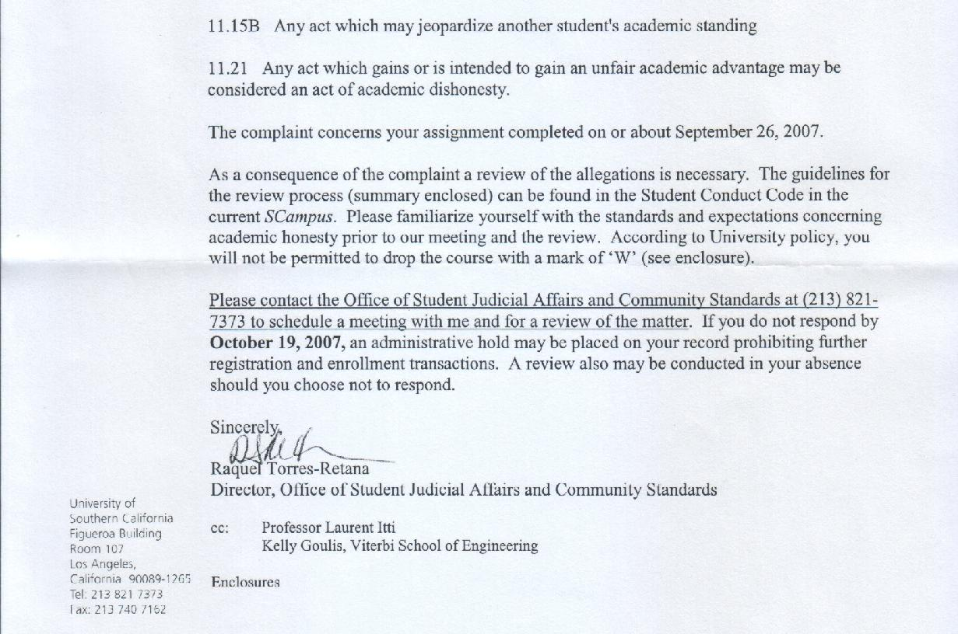

Slide 12
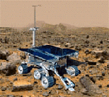

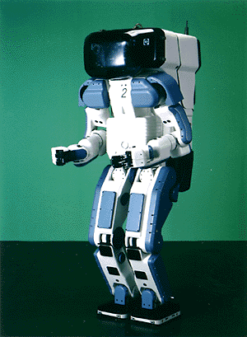

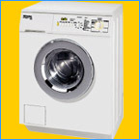
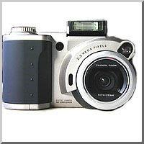
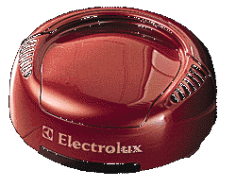
Why study AI?
Search engines
Science
Medicine /
Diagnosis
Labor
Appliances /
Internet of Things (IoT)
What else?

Slide 13
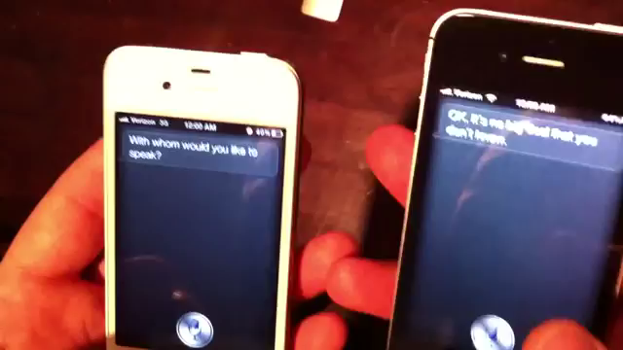
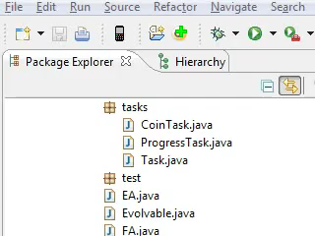
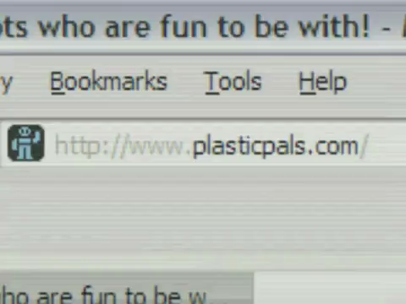
Why study AI?

Slide 14
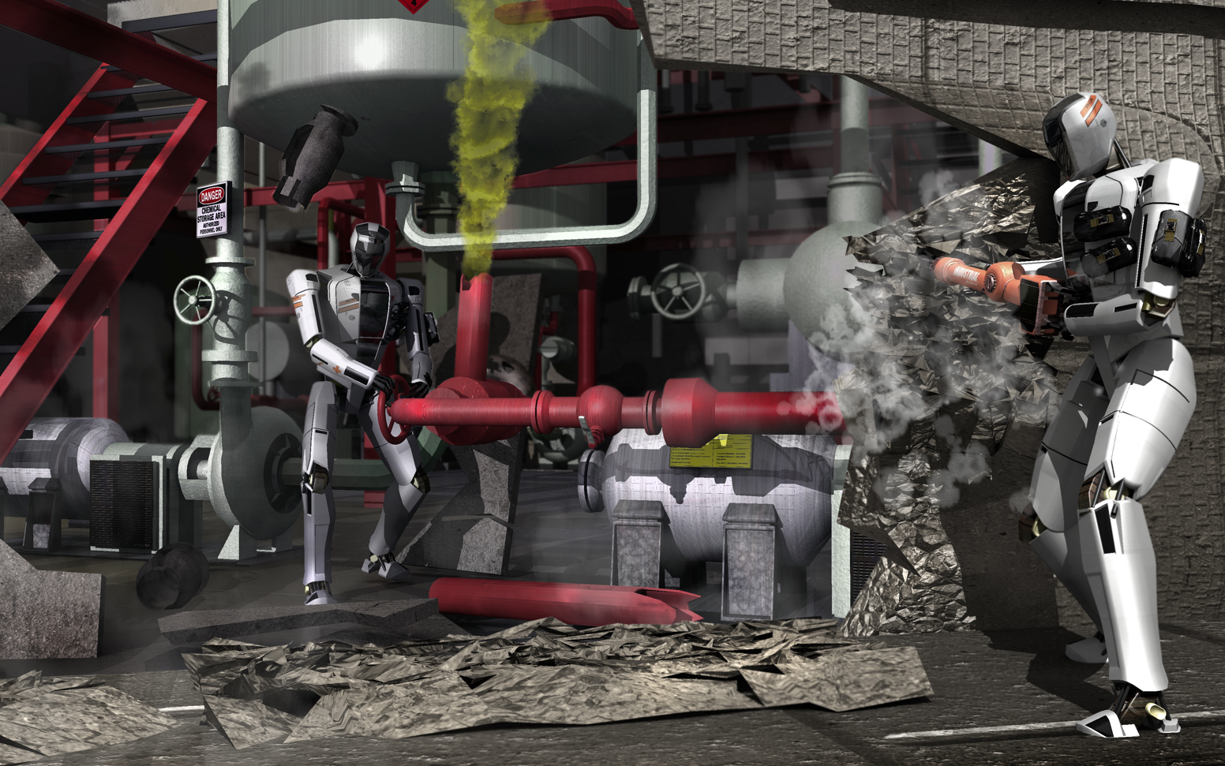
DARPA Robotics Challenge

Slide 15


Slide 16
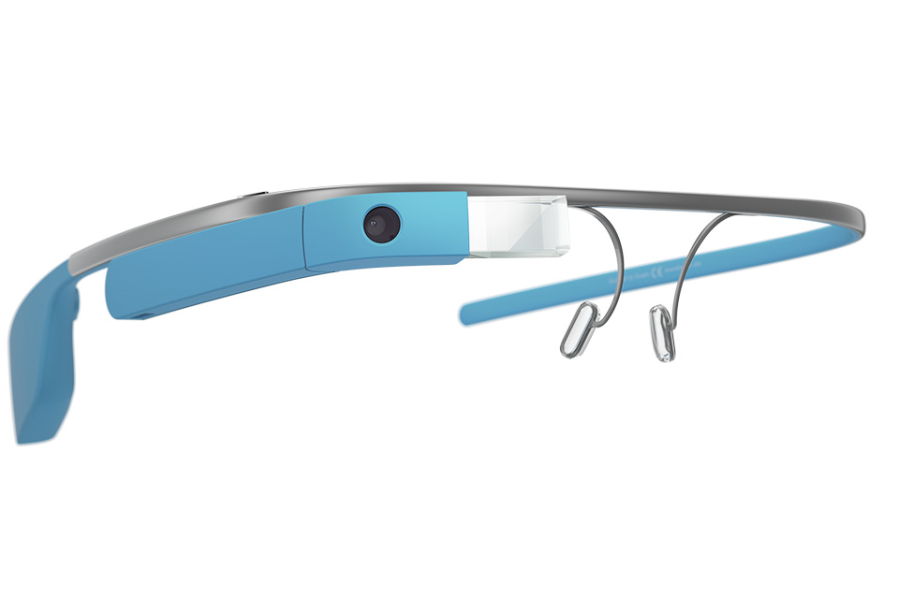
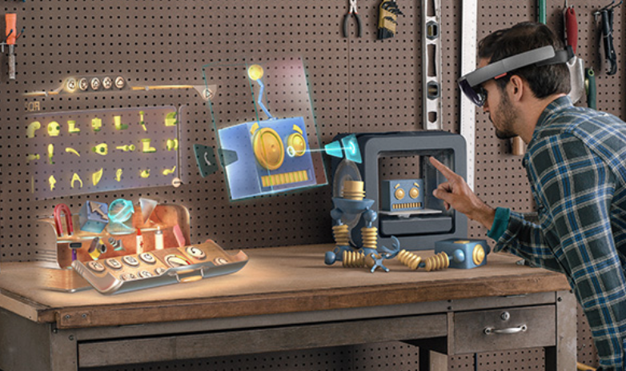
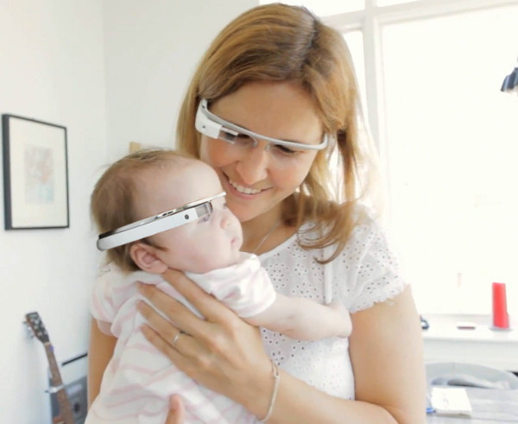
Wearable computing
Google glass
Microsoft Hololens
Zypad

Slide 17

Wearable computing
Google glass
Microsoft Hololens
Zypad

Slide 18
What is AI?
The exciting new effort to make computers think … machines with minds, in the full and literal sense”
(Haugeland 1985)
“The study of mental faculties through the use of computational models”
(Charniak et al. 1985)
“The art of creating machines that perform functions that require intelligence when performed by people” (Kurzweil, 1990)
A field of study that seeks to explain and emulate intelligent behavior in terms of computational processes” (Schalkol, 1990)
Systems that think like humans
Systems that think rationally
Systems that act like humans
Systems that act rationally

Slide 19
Acting Rationally: The Rational Agent
Rational behavior: Doing the right thing!
The right thing: That which is expected to maximize the expected return
Provides the most general view of AI because it includes:
Correct inference (“Laws of thought”)
Uncertainty handling
Resource limitation considerations (e.g., reflex vs. deliberation)
Cognitive skills (NLP, AR, knowledge representation, ML, etc.)
Advantages:
More general
Its goal of rationality is well defined

Slide 20
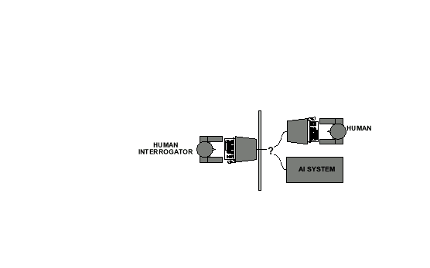
Acting Humanly: The Turing Test
Alan Turing's 1950 article Computing Machinery and Intelligence discussed conditions for considering a machine to be intelligent
“Can machines think?” ←→ “Can machines behave intelligently?”
The Turing test (The Imitation Game): Operational definition of intelligence.

Slide 21
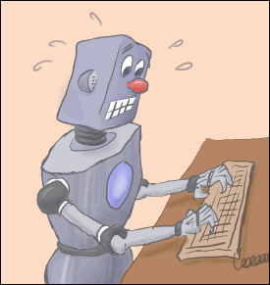
Acting Humanly: The Turing Test
Computer needs to possess: Natural language processing, Knowledge representation, Automated reasoning, and Machine learning
Are there any problems/limitations to the Turing Test?

Slide 22
Acting Humanly: The Full Turing Test
Alan Turing's 1950 article Computing Machinery and Intelligence discussed conditions for considering a machine to be intelligent
“Can machines think?” ←→ “Can machines behave intelligently?”
The Turing test (The Imitation Game): Operational definition of intelligence.
Computer needs to possess: Natural language processing, Knowledge representation, Automated reasoning, and Machine learning
Problem: 1) Turing test is not reproducible, constructive, and amenable to mathematic analysis. 2) What about physical interaction with interrogator and environment?
Total Turing Test: Requires physical interaction and needs perception and actuation.

Slide 23
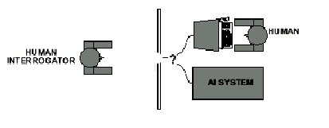
Acting Humanly: The Full Turing Test
Problem:
1) Turing test is not reproducible, constructive, and amenable to mathematic analysis.
2) What about physical interaction with interrogator and environment?
Trap door

Slide 24

What would a computer need to pass the Turing test?
Natural language processing: to communicate with examiner.
Knowledge representation: to store and retrieve information provided before or during interrogation.
Automated reasoning: to use the stored information to answer questions and to draw new conclusions.
Machine learning: to adapt to new circumstances and to detect and extrapolate patterns.

Slide 25
What would a computer need to pass the Turing test?
Natural language processing: to communicate with examiner.
Knowledge representation: to store and retrieve information provided before or during interrogation.
Automated reasoning: to use the stored information to answer questions and to draw new conclusions.
Machine learning: to adapt to new circumstances and to detect and extrapolate patterns.
Core focus in this course

Slide 26
What would a computer need to pass the Turing test?
Vision (for Total Turing test): to recognize the examiner’s actions and various objects presented by the examiner.
Motor control (total test): to act upon objects as requested.
Other senses (total test): such as audition, smell, touch, etc.

Slide 27
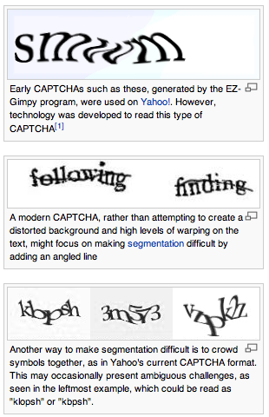
CAPTCHAs or “reverse Turing tests”
Vision is a particularly difficult one for machines…
Gave rise to “Completely Automated Public Turing test to tell Computers and Humans Apart” (CAPTCHA)
wikipedia

Slide 28
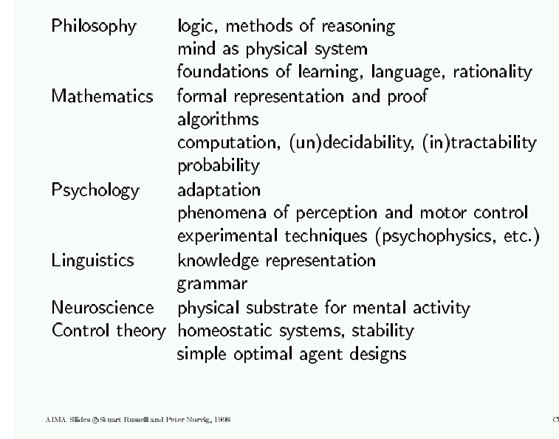
AI Prehistory
28

Slide 29
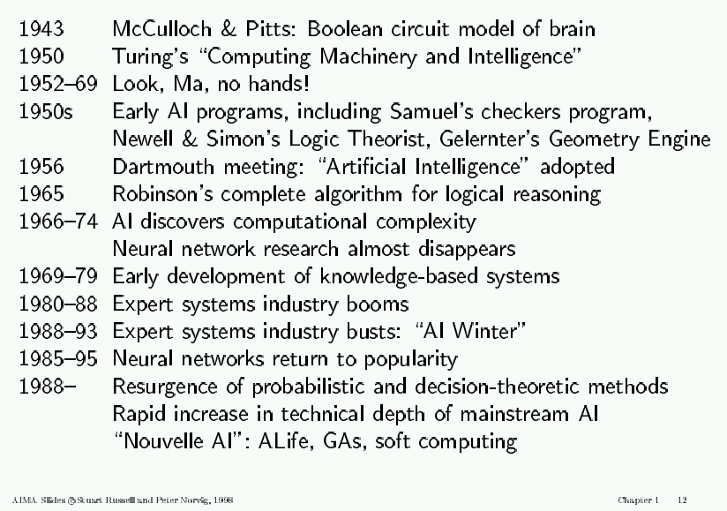
AI History

Slide 30
AI State of the art
Have the following been achieved by AI?
Pass the Turing test
World-class chess playing
Playing table tennis
Cross-country driving
Solving mathematical problems
Discovering and proving mathematical theories
Engaging in a meaningful conversation
Understanding spoken language
Observing and understanding human emotions
Expressing emotions
…

Slide 31
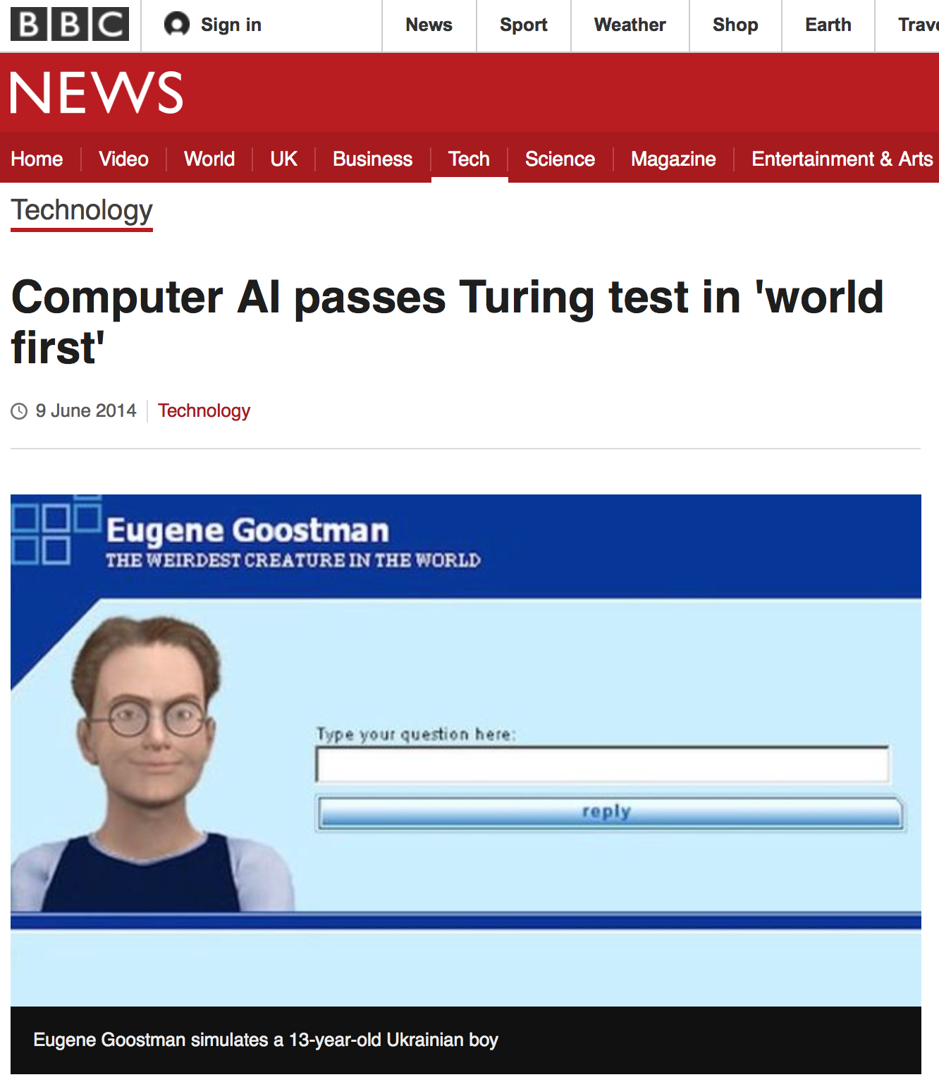
AI State of the art

Slide 32

AI State of the art

Slide 33

AI State of the art

Slide 34

AI State of the art

Slide 35
Course Overview
General Introduction
01-Introduction. [AIMA Ch 1] Course Schedule. Homeworks, exams and grading. Course material, TAs and office hours. Why study AI? What is AI? The Turing test. Rationality. Branches of AI. Research disciplines connected to and at the foundation of AI. Brief history of AI. Challenges for the future. Overview of class syllabus.
Intelligent Agents. [AIMA Ch 2] What is
an intelligent agent? Examples. Doing the right
thing (rational action). Performance measure.
Autonomy. Environment and agent design.
Structure of agents. Agent types. Reflex agents.
Reactive agents. Reflex agents with state.
Goal-based agents. Utility-based agents. Mobile
agents. Information agents.
Agent
sensors
effectors

Slide 36
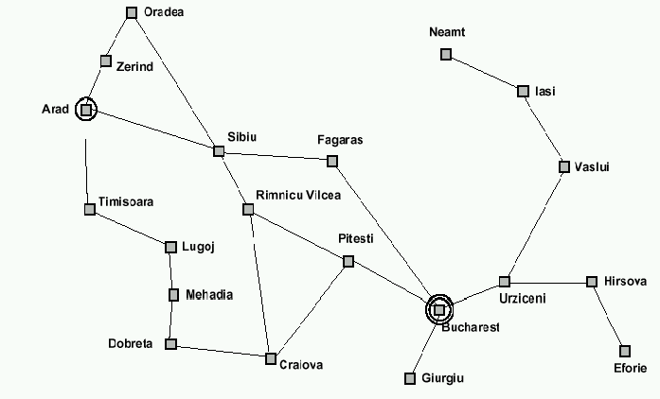
Course Overview (cont.)
How can we solve complex problems?
02-Problem solving and search. [AIMA Ch 3] Example: measuring problem. Types of problems. More example problems. Basic idea behind search algorithms. Complexity. Combinatorial explosion and NP completeness. Polynomial hierarchy.
03/04-Uninformed search. [AIMA Ch 3] Depth-first. Breadth-first. Uniform-cost. Depth-limited. Iterative deepening. Examples. Properties.
05/06-Informed search. [AIMA Ch 4] Best-first. A* search. Heuristics. Hill climbing. Problem of local extrema. Simulated annealing. Genetic algorithms.
9 l
3 l
5 l
Using these 3 buckets,
measure 7 liters of water.
Traveling salesperson problem

Slide 37
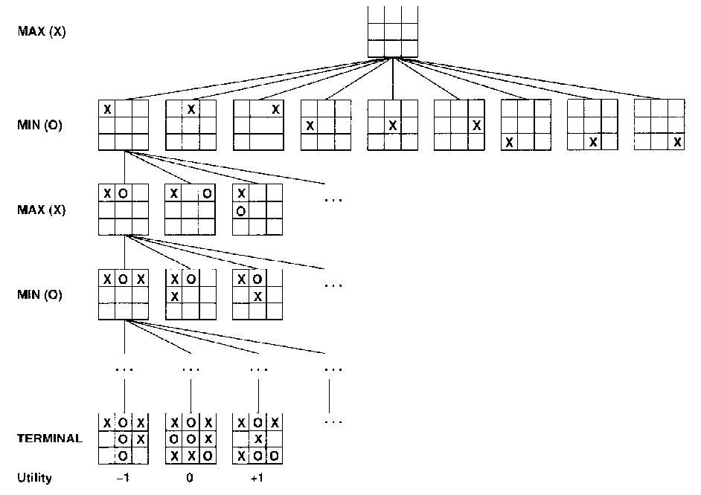
Course Overview (cont.)
Practical applications of search.
07-Game playing. [AIMA Ch 5] The minimax algorithm. Resource limitations. Aplha-beta pruning. Elements of
chance and non-
deterministic games.
tic-tac-toe
37

Slide 38
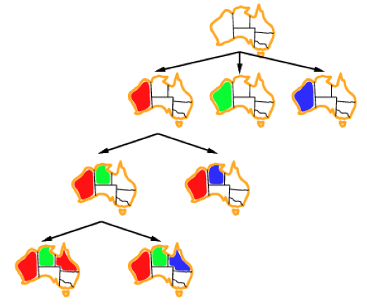
Course Overview (cont.)
Search under constraints
08-Constraint satisfaction. [AIMA Ch 6] Node, arc, path, and k-consistency. Backtracking search. Local search using min-conflicts.
Map coloring
38

Slide 39
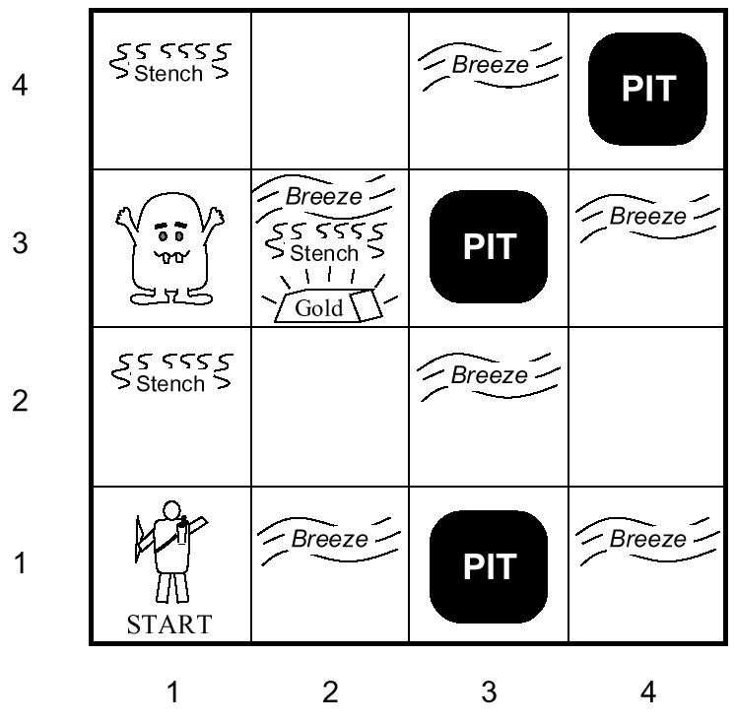
Course Overview (cont.)
9-Agents that reason logically 1. [AIMA Ch 7] Knowledge-based agents. Logic and representation. Propositional (boolean) logic.
10-Agents that reason logically 2. [AIMA Ch 7] Inference in propositional logic. Syntax. Semantics. Examples.
Towards intelligent agents
wumpus world

Slide 40
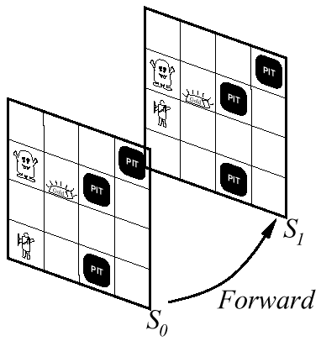
Course Overview (cont.)
Building knowledge-based agents: 1st Order Logic
11-First-order logic 1. [AIMA Ch 8] Syntax. Semantics. Atomic sentences. Complex sentences. Quantifiers. Examples. FOL knowledge base. Situation calculus.
12-First-order logic 2.
[AIMA Ch 8] Describing actions.
Planning. Action sequences.

Slide 41
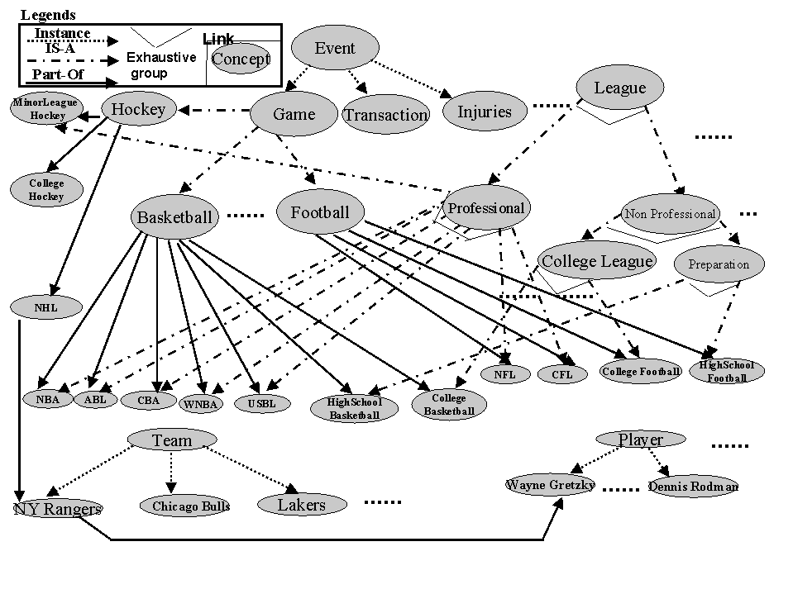
Course Overview (cont.)
Representing and Organizing Knowledge
13-Building a knowledge base. [AIMA Ch 12] Knowledge bases. Vocabulary and rules. Ontologies. Organizing knowledge.
An ontology
for the sports
domain

Slide 42
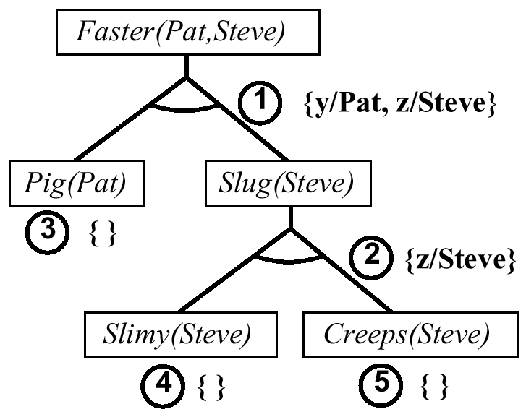
Course Overview (cont.)
Reasoning Logically
14/15-Inference in first-order logic. [AIMA Ch 9] Proofs. Unification. Generalized modus ponens. Forward and backward chaining.
Example of
backward chaining

Slide 43
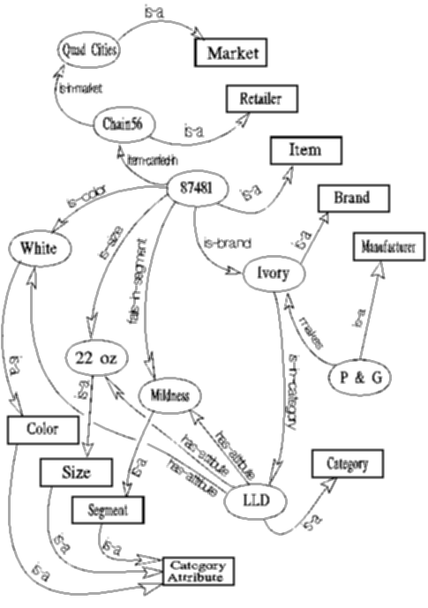
Course Overview (cont.)
Examples of Logical Reasoning Systems
16-Logical reasoning systems.
[AIMA Ch 9] Indexing, retrieval
and unification. The Prolog language.
Theorem provers. Frame systems
and semantic networks.
Semantic network
used in an insight
generator (Duke
university)

Slide 44
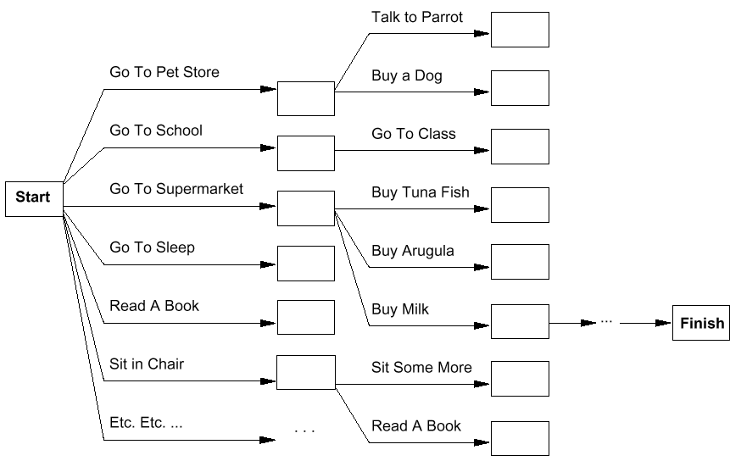
Course Overview (cont.)
Systems that can Plan Future Behavior
17-Planning. [AIMA Ch 10] Definition and goals. Basic representations for planning. Situation space and plan space. Examples.

Slide 45
Course Overview (cont.)
Handling fuzziness, change, uncertainty.
18-Fuzzy logic. [handout]. Fuzzy variables, fuzzy inference, aggregation, defuzzification.
Center of gravity
Center of largest area

Slide 46
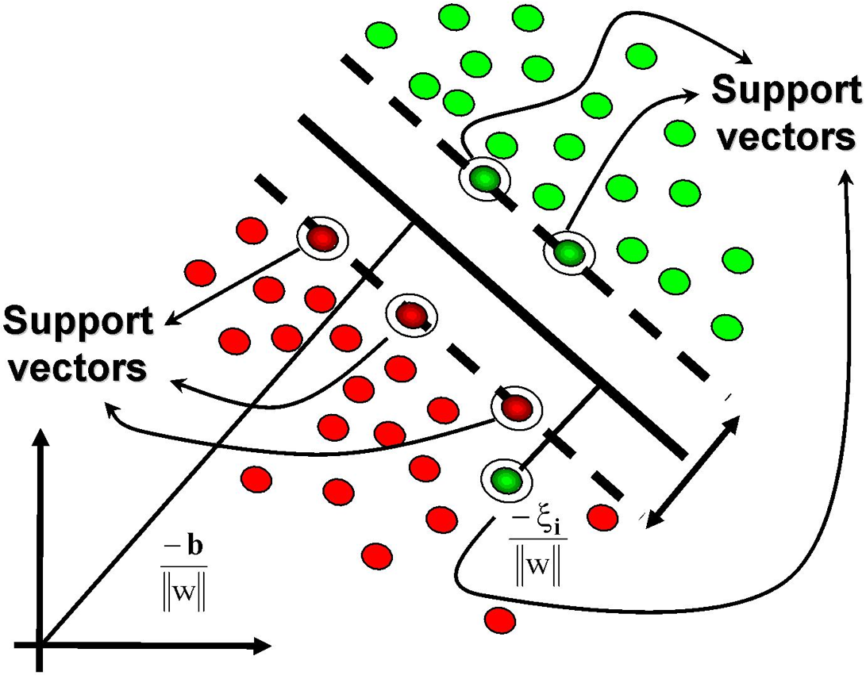
Course Overview (cont.)
Handling fuzziness, change, uncertainty.
19-Learning from examples. [AIMA 18 + handout]. Supervised learning, learning decision trees, support vector machines.

Slide 47
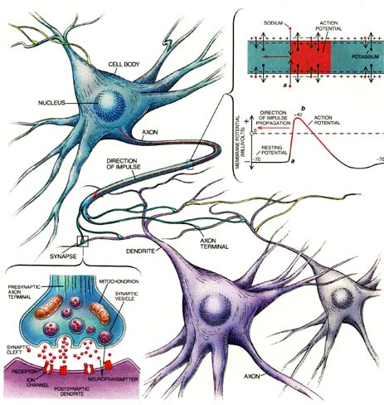
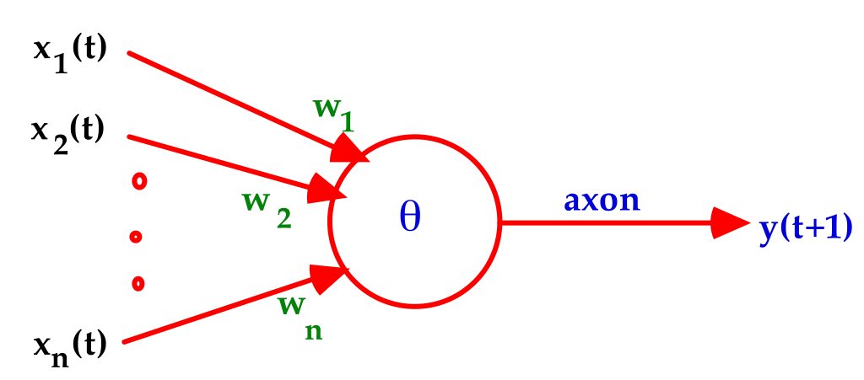
Course Overview (cont.)
Learning with Neural networks
20/21-Learning with Neural Networks.
[Handout + AIMA 18] Introduction to perceptrons, Hopfield networks, self-organizing feature maps. How to size a network? What can neural networks achieve? Advanced concepts – convnets, deep learning, stochastic gradient descent, dropout learning, autoencoders, applications and state of the art.

Slide 48
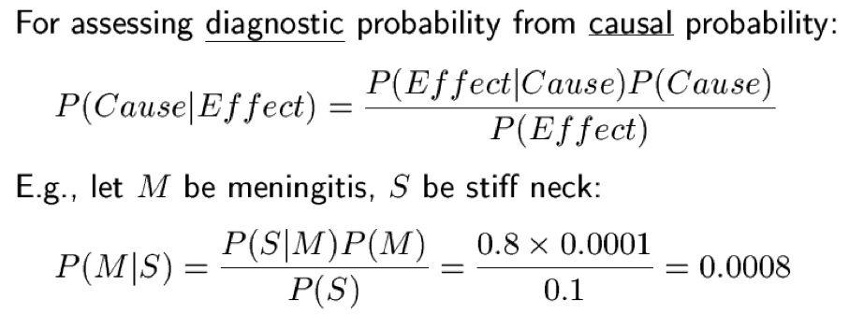
Course Overview (cont.)
22/23-Probabilistic reasoning. [AIMA Ch 13, 14, 15]
Reasoning under uncertainty – probabilities, conditional independence, Markov blanket, Bayes nets. Probabilistic reasoning in time. Hidden Markov Models, Kalman filters, dynamic Bayesian networks.
Handling fuzziness, change, uncertainty.

Slide 49
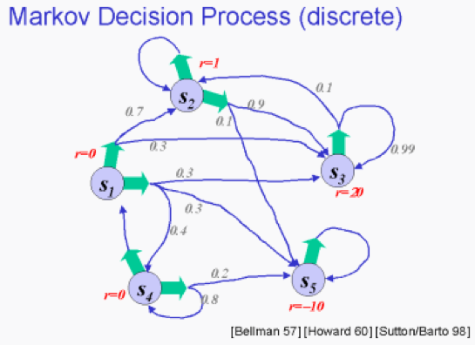
Course Overview (cont.)
24-Probabilistic decision making. [AIMA 16, 17] – utility theory, decision networks, value iteration, policy iteration, Markov decision processes (MDP), partially-observable MDP (POMDP).
Handling fuzziness, change, uncertainty.

Slide 50
Course Overview (cont.)
25-Probabilistic reasoning over time. [AIMA 15]
Temporal models, Hidden Markov Models, Kalman filters, Dynamic Bayesian Networks, Automata theory.
Handling fuzziness, change, uncertainty.

Slide 51
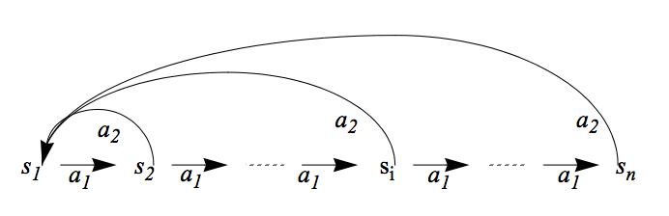
Course Overview (cont.)
26-Probability-based learning. [AIMA 20-21]
Probabilistic Models, Naïve Bayes Models, EM algorithm, Reinforcement Learning.
Handling fuzziness, change, uncertainty.

Slide 52
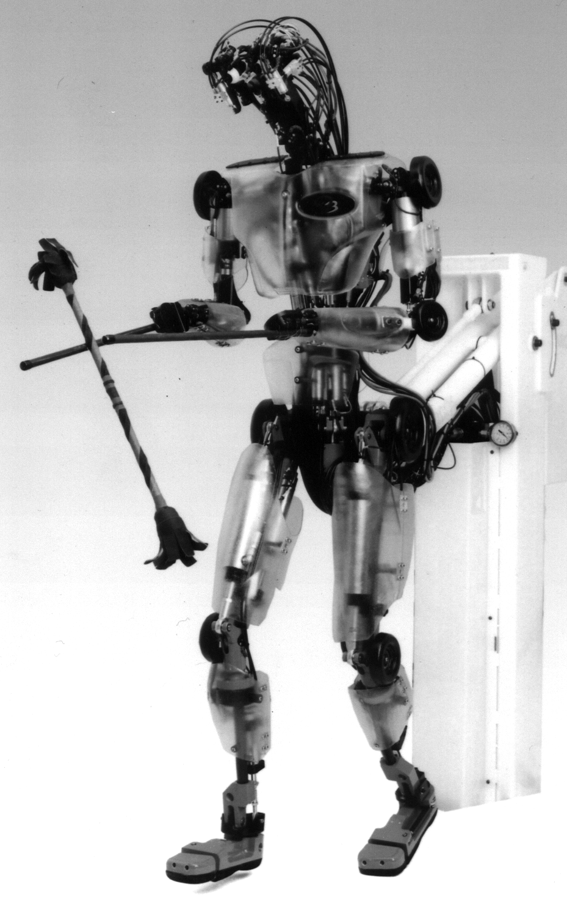
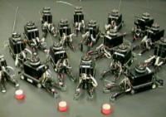
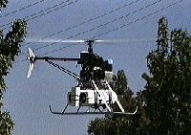
Course Overview (cont.)
What challenges remain?
27-Natural language processing. [AIMA Ch 22, 23] Language models, information retrieval, syntactic analysis, machine translation, speech recognition.
28-Towards intelligent machines. [AIMA Ch 26, 27] The challenge of robots: with what we have learned, what hard problems remain to be solved? Different types of robots. Tasks that robots are for. Parts of robots. Architectures. Configuration spaces. Navigation and motion planning. Towards highly-capable robots. What have we learned. Where do we go from here?
robotics@USC

Slide 53
Defining intelligent agents
Intelligent Agents (IA)
Environment types
IA Behavior
IA Structure
IA Types

Slide 54
What is an (Intelligent) Agent?
An over-used, over-loaded, and misused term.
Anything that can be viewed as perceiving its environment through sensors and acting upon that environment through its effectors to maximize progress towards its goals.

Slide 55
What is an (Intelligent) Agent?
PAGE (Percepts, Actions, Goals, Environment)
Task-specific & specialized: well-defined goals and environment
The notion of an agent is meant to be a tool for analyzing systems,
It is not a different hardware or new programming languages

Slide 56
Rational Agents
How to design this?
Sensors
percepts
Environment
?
Agent
actions
Effectors

Slide 57
A Windshield Wiper Agent
How do we design a agent that can wipe the windshields
when needed?
Goals?
Percepts?
Sensors?
Effectors?
Actions?
Environment?

Slide 58
A Windshield Wiper Agent (Cont’d)
Goals: Keep windshields clean & maintain visibility
Percepts: Raining, Dirty
Sensors: Camera (moist sensor)
Effectors: Wipers (left, right, back)
Actions: Off, Slow, Medium, Fast
Environment: Inner city, freeways, highways, weather …

Slide 59
Interacting Agents
Collision Avoidance Agent (CAA)
Goals: Avoid running into obstacles
Percepts ?
Sensors?
Effectors ?
Actions ?
Environment: Freeway
Lane Keeping Agent (LKA)
Goals: Stay in current lane
Percepts ?
Sensors?
Effectors ?
Actions ?
Environment: Freeway

Slide 60
Interacting Agents
Collision Avoidance Agent (CAA)
Goals: Avoid running into obstacles
Percepts: Obstacle distance, velocity, trajectory
Sensors: Vision, proximity sensing
Effectors: Steering Wheel, Accelerator, Brakes, Horn, Headlights
Actions: Steer, speed up, brake, blow horn, signal (headlights)
Environment: Freeway
Lane Keeping Agent (LKA)
Goals: Stay in current lane
Percepts: Lane center, lane boundaries
Sensors: Vision
Effectors: Steering Wheel, Accelerator, Brakes
Actions: Steer, speed up, brake
Environment: Freeway

Slide 61
Conflict Resolution by Action Selection Agents
Override: CAA overrides LKA
Arbitrate: if Obstacle is Close then CAA else LKA
Compromise: Choose action that satisfies both agents
Any combination of the above
Challenges: Doing the right thing

Slide 62
The Right Thing = The Rational Action
Rational Action: The action that maximizes the expected value of the performance measure given the percept sequence to date
Rational = Best ?
Rational = Optimal ?
Rational = Omniscience ?
Rational = Clairvoyant ?
Rational = Successful ?

Slide 63
The Right Thing = The Rational Action
Rational Action: The action that maximizes the expected value of the performance measure given the percept sequence to date
Rational = Best Yes, to the best of its knowledge
Rational = Optimal Yes, to the best of its abilities (incl.
Rational ≠ Omniscience its constraints)
Rational ≠ Clairvoyant
Rational ≠ Successful

Slide 64
Behavior and performance of IAs
Perception (sequence) to Action Mapping: f : P* → A
Ideal mapping: specifies which actions an agent ought to take at any point in time
Implementation: Look-Up-Table, Closed Form, Algorithm, etc.
Performance measure: a subjective measure to characterize how successful an agent is (e.g., speed, power usage, accuracy, money, etc.)
(degree of) Autonomy: to what extent is the agent able to make decisions and take actions on its own?

Slide 65
Look up table
Distance | Action
10 | No action
5 | Turn left 30 degrees
2 | Stop
obstacle
sensor
agent

Slide 66
Closed form
Output (degree of rotation) = F(distance)
E.g., F(d) = 10/d (distance cannot be less than 1/10)

Slide 67
How is an Agent different from other software?
Agents are autonomous, that is, they act on behalf of the user
Agents contain some level of intelligence, from fixed rules to learning engines that allow them to adapt to changes in the environment
Agents don't only act reactively, but sometimes also proactively
Agents have social ability, that is, they communicate with the user, the system, and other agents as required
Agents may also cooperate with other agents to carry out more complex tasks than they themselves can handle
Agents may migrate from one system to another to access remote resources or even to meet other agents

Slide 68
Environment Types
Characteristics
Accessible vs. inaccessible
Deterministic vs. nondeterministic
Episodic vs. nonepisodic
Hostile vs. friendly
Static vs. dynamic
Discrete vs. continuous

Slide 69
Environment Types
Characteristics
Accessible vs. inaccessible
Sensors give access to complete state of the environment.
Deterministic vs. nondeterministic
The next state can be determined based on the current state and the action.
Episodic vs. nonepisodic (Sequential)
Episode: each perceive and action pairs
The quality of action does not depend on the previous episode.

Slide 70
Environment Types
Characteristics
Hostile vs. friendly
Static vs. dynamic
Dynamic if the environment changes during deliberation
Discrete vs. continuous
Chess vs. driving

Slide 71
Environment types
Environment | Accessible | Deterministic | Episodic | Static | Discrete
Operating System
Virtual Reality
Office Environment
Mars

Slide 72
Environment types
Environment | Accessible | Deterministic | Episodic | Static | Discrete
Operating System | Yes | Yes | No | No | Yes
Virtual Reality | Yes | Yes | Yes/no | No | Yes/no
Office Environment | No | No | No | No | No
Mars | No | Semi | No | Semi | No
The environment types largely determine the agent design.

Slide 73
Structure of Intelligent Agents
Agent = architecture + program
Agent program: the implementation of f : P* → A, the agent’s perception-action mapping function Skeleton-Agent(Percept) returns Action memory ← UpdateMemory(memory, Percept) Action ← ChooseBestAction(memory) memory ← UpdateMemory(memory, Action) return Action
Architecture: a device that can execute the agent program (e.g., general-purpose computer, specialized device, beobot, etc.)

Slide 74
Using a look-up-table to encode f : P* → A
Example: Collision Avoidance
Sensors: 3 proximity sensors
Effectors: Steering Wheel, Brakes
How to generate?
How large?
How to select action?
obstacle
sensors
agent

Slide 75
Using a look-up-table to encode f : P* → A
Example: Collision Avoidance
Sensors: 3 proximity sensors
Effectors: Steering Wheel, Brakes
How to generate: for each p ∈ P_{l} × P_{m} × P_{r} generate an appropriate action, a ∈ S × B
How large: size of table = #possible percepts times # possible actions = |P_{l} | |P_{m}| |P_{r}| |S| |B| E.g., P = {close, medium, far}³ A = {left, straight, right} × {on, off} then size of table = 27 rows
Total possible combinations (ways to fill table): 27*3*2=162
How to select action? Search.
obstacle
sensors
agent

Slide 76
Agent types
Reflex agents
Reflex agents with internal states
Goal-based agents
Utility-based agents
Learning agents

Slide 77
Agent types
Reflex agents
Reactive: No memory
Reflex agents with internal states
W/o previous state, may not be able to make decision
E.g. brake lights at night.
Goal-based agents
Goal information needed to make decision

Slide 78
Agent types
Utility-based agents
How well can the goal be achieved (degree of happiness)
What to do if there are conflicting goals?
Speed and safety
Which goal should be selected if several can be achieved?
Learning agents
How can I adapt to the environment?
How can I learn from my mistakes?

Slide 79
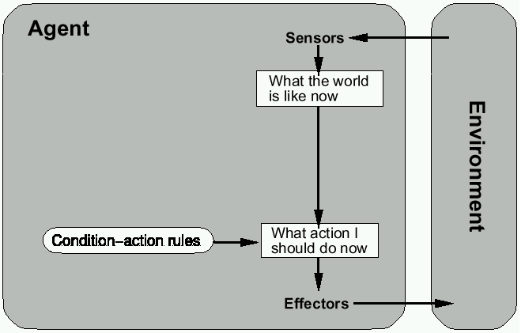
Reflex agents

Slide 80
Reactive agents
Reactive agents do not have internal symbolic models.
Act by stimulus-response to the current state of the environment.
Each reactive agent is simple and interacts with others in a basic way.
Complex patterns of behavior emerge from their interaction.
Benefits: robustness, fast response time
Challenges: scalability, how intelligent? and how do you debug them?

Slide 81
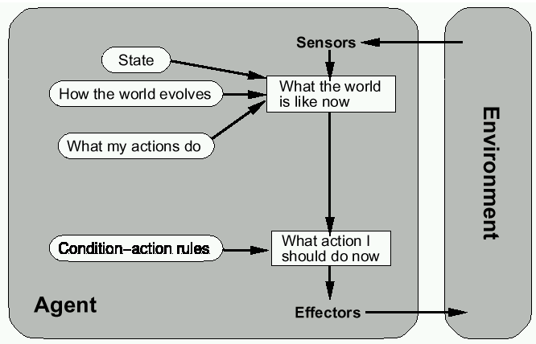
Reflex agents w/ state

Slide 82
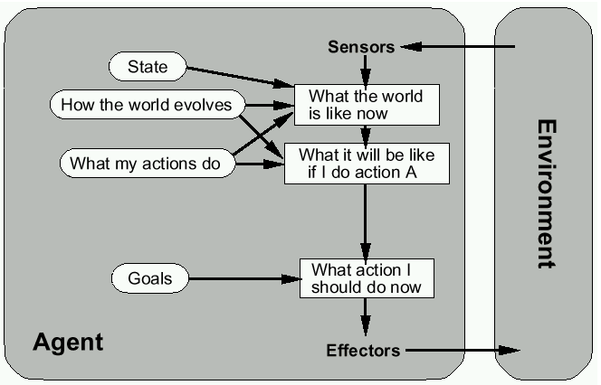
Goal-based agents

Slide 83
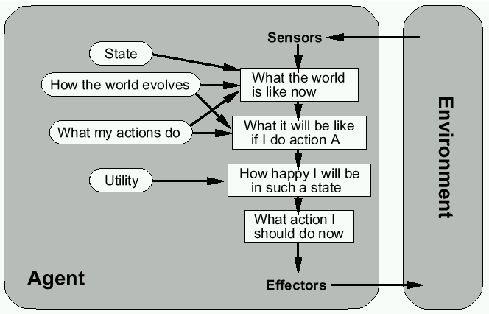
Utility-based agents

Slide 84
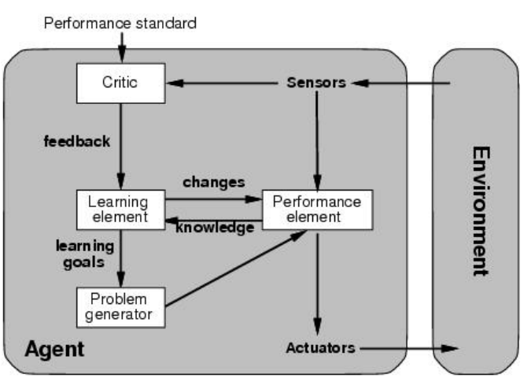
Learning agents

Slide 85
Summary on intelligent agents
Intelligent Agents:
Anything that can be viewed as perceiving its environment through sensors and acting upon that environment through its effectors to maximize progress towards its goals.
PAGE (Percepts, Actions, Goals, Environment)
Described as a Perception (sequence) to Action Mapping: f : P* → A
Using look-up-table, closed form, etc.
Agent Types: Reflex, state-based, goal-based, utility-based, learning
Rational Action: The action that maximizes the expected value of the performance measure given the percept sequence to date

Slide 86
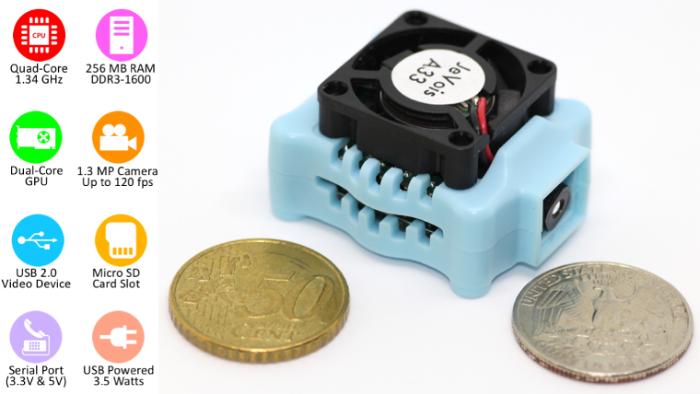
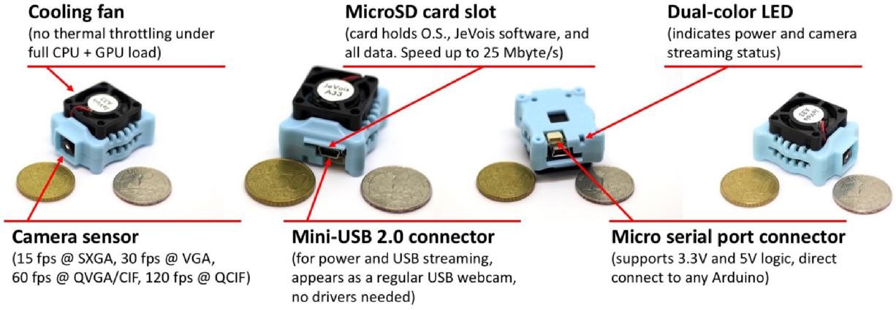
Interested in AI research in prof. Itti’s lab?
Please see new open-source machine vision, AI & robotics effort at http://jevois.org
JeVois is a small USB webcam with quad-core processor inside. It runs Linux. You can program it in C++ or Python. It can stream processed video over USB and issue text messages (e.g., to an Arduino) over serial port.
Full disclosure: We also manufacture and sell these cameras.

Slide 87
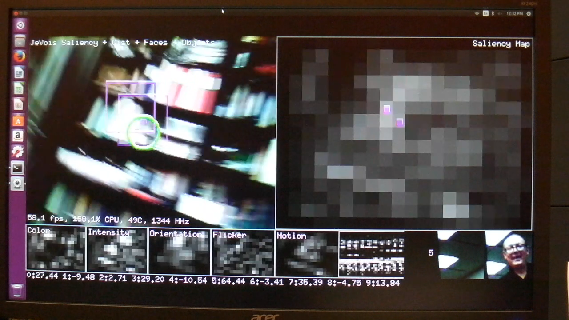
JeVois examples of on-board machine vision

Slide 88


JeVois case study
A robot that follows ArUco markers.
Use existing JeVois ArUco machine vision module.
Build robot and program an Arduino to control the motors (~250 lines of C++)
http://jevois.org/tutorials

Slide 89
Interested?
This is not for extra credit but it can add to your resume
Please do not email me yet (too many emails already)
Review the material at http://jevois.org
We will setup a workgroup about this on Wednesday after class.

